Slide 1
Testing Water Quality at the Library
With Surfrider and the Wet Lab
4/21/2018

Slide 2
Water Quality
Government agencies and volunteer groups monitor rivers, lakes, and the ocean to detect pollution and monitor whether the water is safe for recreation and aquatic life.
The next few slides will introduce you to the different methods that are used to monitor water quality and the groups that are doing it.
After the introduction you will have the opportunity to try out some of the tests on three *mystery samples* or your own samples if you wish

Slide 3
Temperature
Measurement of thermal energy of the water
Temperate effects which animals and plants can survive in the water, photosynthesis rates, and metabolic rates
When temperature goes up, solubility of toxic materials and salts goes up and dissolved oxygen content goes down
Water temp can also change pH, density, and conductivity of water
Water temp is effected by sunlight, atmospheric temperature, inflow from rivers, and human-caused effects such as industrial discharge and deforestation

Slide 4
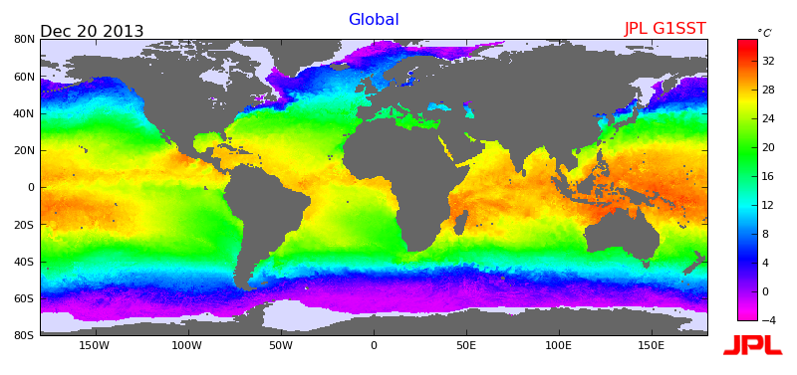
Global sea surface temperatures, December 31

Slide 5
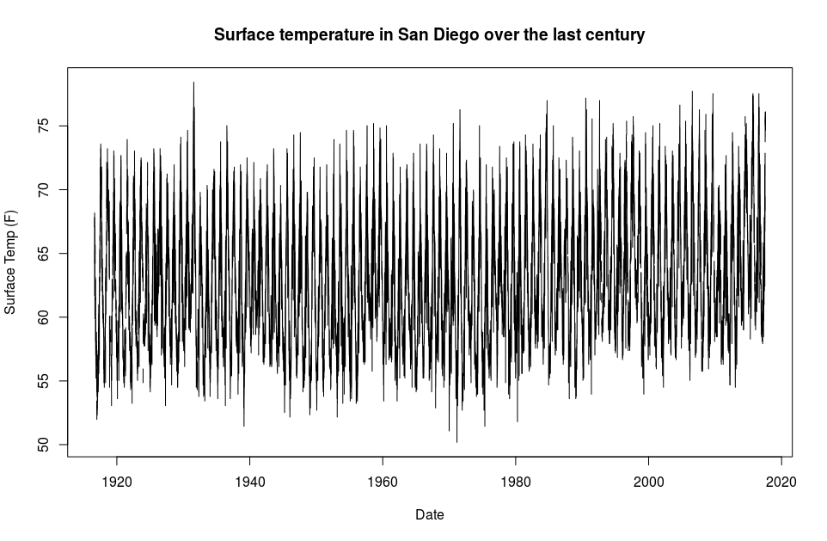
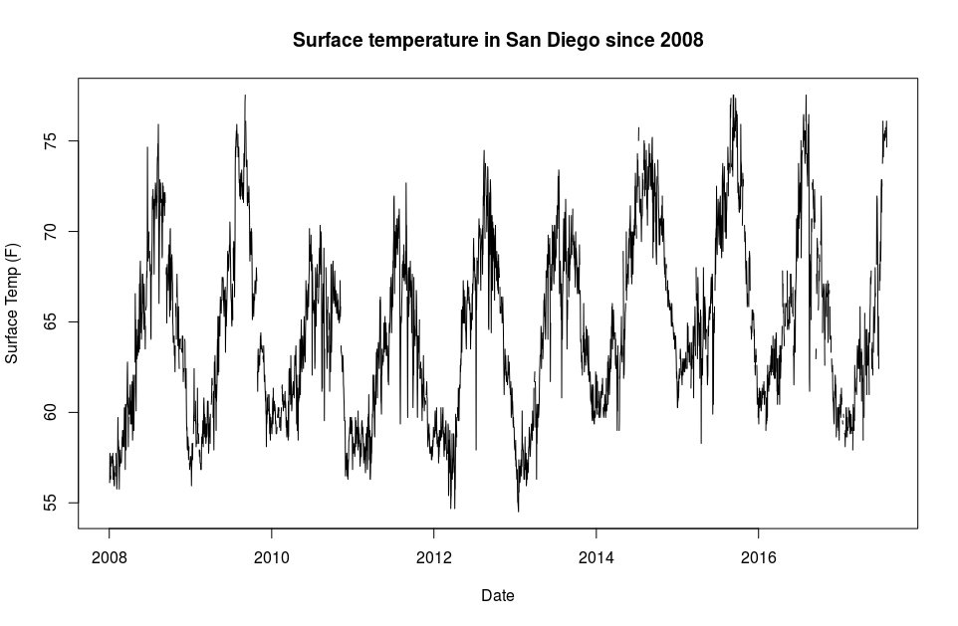
Seawater temperature trends in San Diego
Clear seasonal trends
Range ~53-75 F with slight upward trend since 1980
https://scripps.ucsd.edu/programs/shorestations/shore-stations-data/data-sio/

Slide 6
pH
Measure of how acidic or basic water is- an acid is anything that increases the H+ concentration and a base is anything that reduces it
pH = -log₁₀([H+]) “power of hydrogen”
Organisms have a range of pH that they are adapted to
Oceanic organisms are more sensitive to drops in pH than freshwater organisms
Photosynthesis raises pH and decomposition lowers it
Also influenced by surrounding rock and CO2 in atmosphere
We will measure pH with a probe
Check Coastkeeper website for trends in pH in SD watersheds

Slide 7
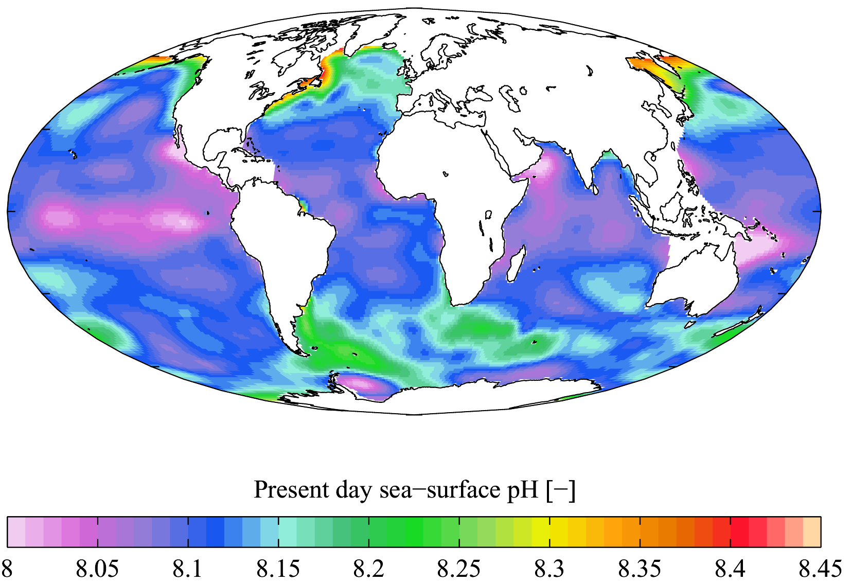
Sea surface pH- from World Ocean Atlas

Slide 8
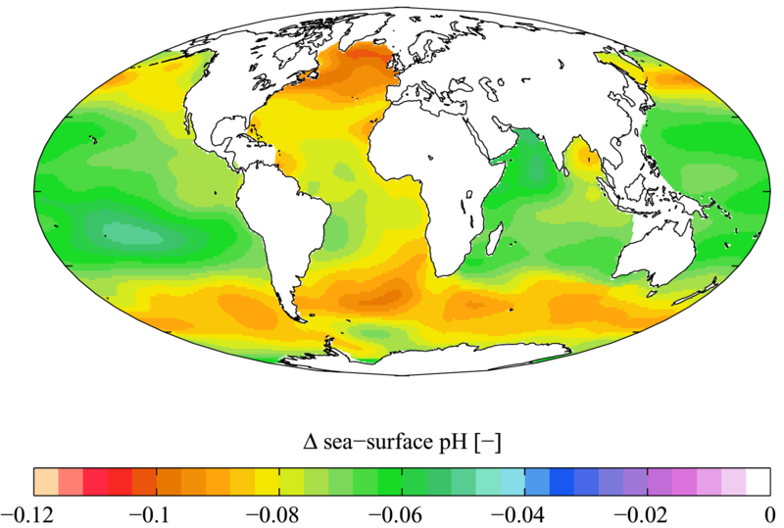
Change in sea surface pH, 1700-1990 from World Ocean Atlas

Slide 9
Salinity, Conductivity, and Total Dissolved Solids
Conductivity is the ability of the water to carry an electric current
Salinity is the total concentration of dissolved salts and is a strong contributor to conductivity
TDS is similar to salinity but also includes dissolved organic matter
Rainfall, snow melt, industrial pollution, agricultural runoff can all change salinity and TDS.
Organisms are adapted to a specific range of salinities and their sensitivity to changes varies
We will measure salinity, conductivity, and TDS with a Hach probe

Slide 10
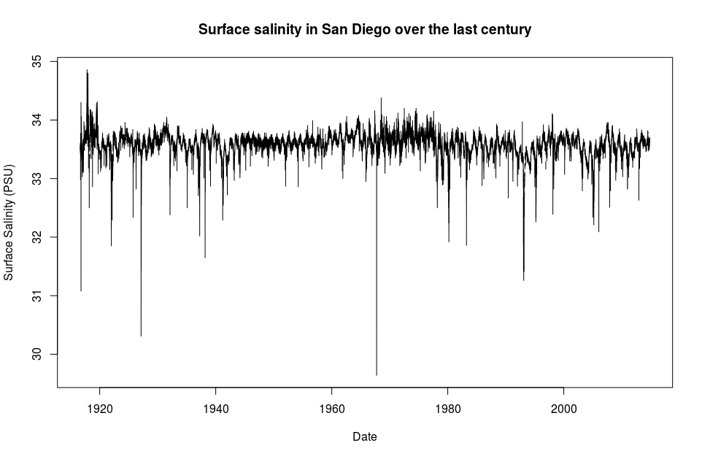
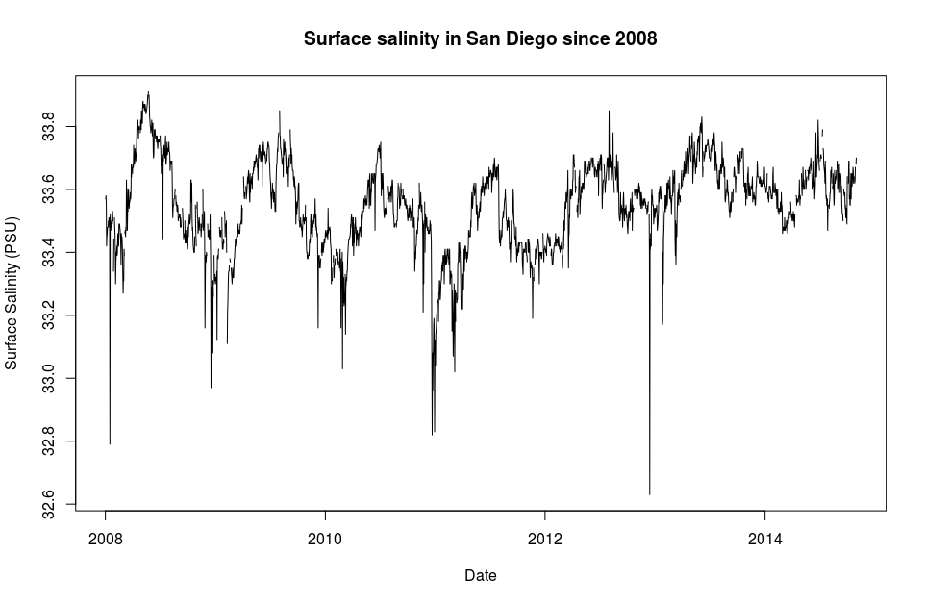
Seawater salinity trends in San Diego
Salinity is fairly constant around 33.6 PSU with occasional dramatic drops
Also have seasonal trend
PSU (practical salinity units) is the same as ppt or g/kg
https://scripps.ucsd.edu/programs/shorestations/shore-stations-data/data-sio/

Slide 11
Turbidity and Total Suspended Solids (TSS)
Particle < 2 microns = dissolved solid, > 2 microns = suspended solid
Particles can be inorganic like silt and sand, or organisms like algae
Turbidity is an optical measure of water clarity based on the amount of light scattered by materials in the water
TSS contributes to turbidity, but turbidity also includes dissolved colored organic matter
Some water is naturally turbid, but a sudden increase is a concern
Turbidity lowers available light for photosynthesis, increases temp
Can be caused by increased water flow, construction, mining, wastewater, dredging
We will use the Secchi method to measure turbidity

Slide 12
Dissolved oxygen (DO)
Free oxygen in water is essential for most aquatic life, including fish, invertebrates, plants, microbes, phytoplankton
Photosynthesis and aeration increase DO, respiration and decomposition decrease DO
Sudden drops in DO can kill fish and other organisms
Marine organisms are more tolerant of drops in DO than freshwater organisms
This is a very important parameter for monitoring the environment, but we will not be doing it today

Slide 13
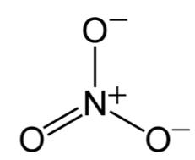
Nitrate and phosphate
Nitrogen and phosphorous are essential nutrients for plant growth and are commonly used in fertilizer
Nitrogen can take the form of ammonia, nitrate, and nitrite. We will be using a colorimetric method to measure nitrate.
We will use a colorimetric test for orthophosphate, although phosphorous can be found in more complex structures
These chemicals can come from natural sources but often are pollution associated with agricultural runoff or wastewater
Nitrate and phosphate can cause blooms of algae which cause increased turbidity and deplete oxygen in waters when they decompose

Slide 14
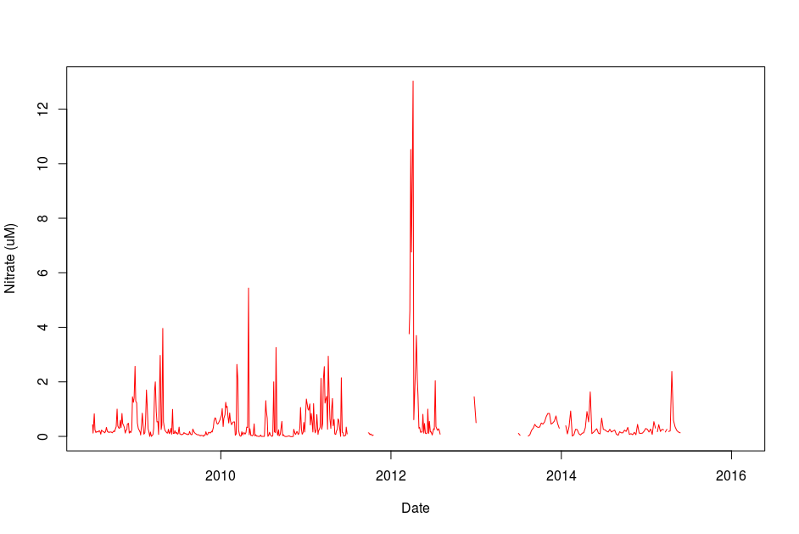
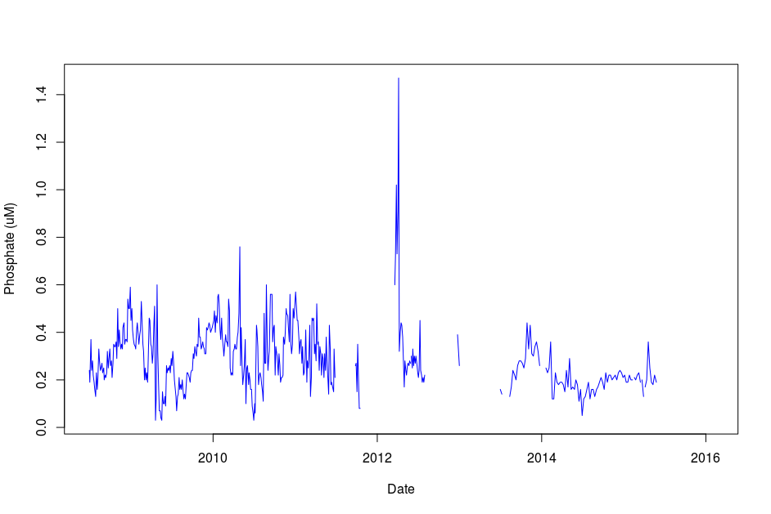
Nitrate and phosphate data from Scripps Pier

Slide 15
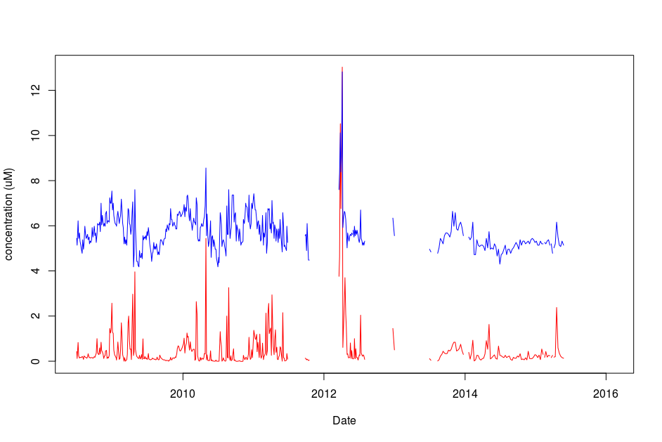
Nitrate (red) and phosphate (blue) data overlain.
Phosphate data is multiplied by 6 and shifted for clarity.

Slide 16
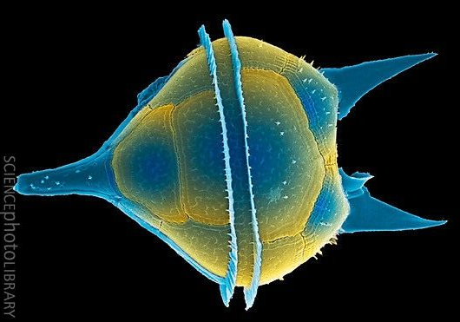
Harmful algae blooms
Refers to rapid growth of certain dinoflagellate and diatom species
These species produce toxins that can kill fish, harm mammals, and make shellfish toxic to eat
Common effects include red tides, paralytic shellfish poisoning, and diarrheic shellfish poisoning
When masses of algae die and decompose they can deplete oxygen in the water
Cells can be counted directly or chlorophyll levels can be used as a proxy
Blooms happen sporadically. Check SCCOOS website for most current data.

Slide 17
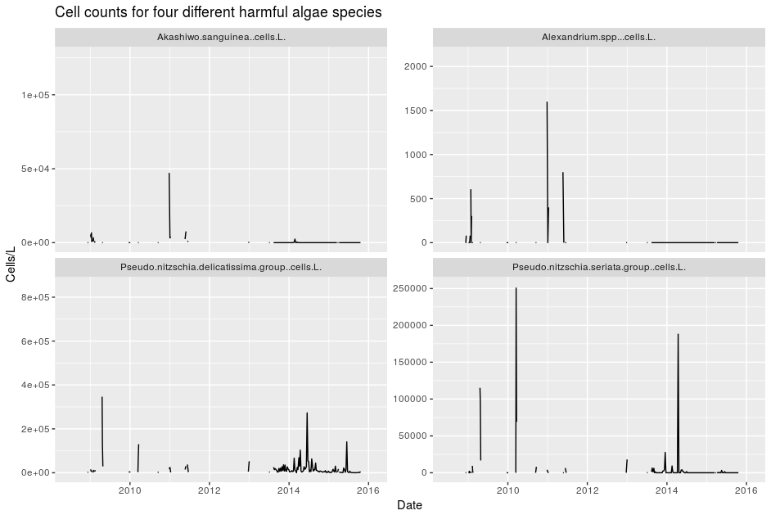
Data collected by SCCOOS off Scripps Pier: http://www.sccoos.org/data/overview/

Slide 18
Fecal indicator bacteria
Fecal indicator bacteria are not themselves pathogenic, but they are associated with sewage, indicating that pathogens may also be present
Three tests are commonly used:
  Enterococcus- common genus of sphere-shaped bacteria that lives in gut of humans
  Fecal coliform- rod-shaped bacteria common to guts of warm blooded animals (included E. coli)
  Total coliform- broad of class of rod-shaped bacteria common in the environment that includes fecal coliform and E. coli.
We will use Idexx Quantitrays to see how Enterococcus is measured
We will also see how plate counts are used to estimate the total density of heterotrophic bacteria in the water

Slide 19
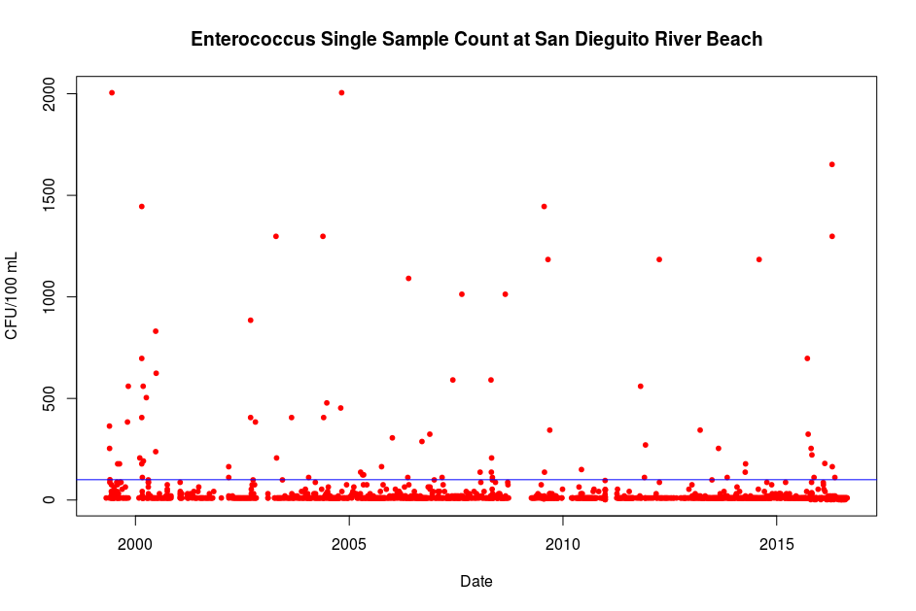
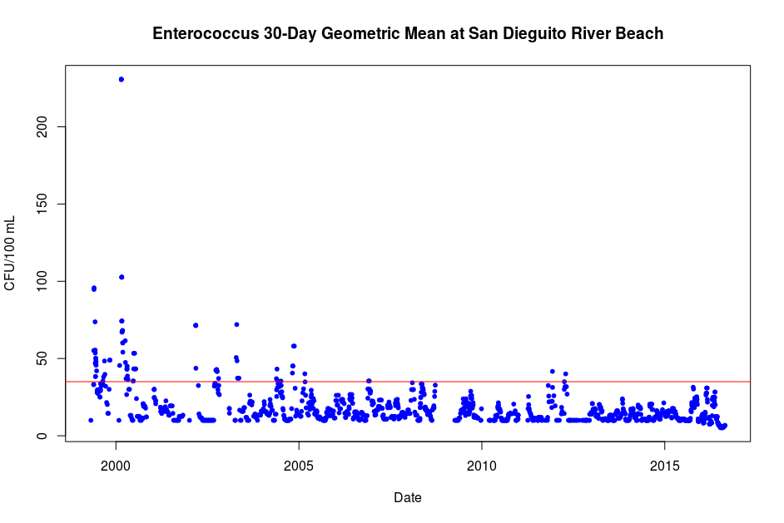
 | Single sample maximum | 30-day geometric mean
Total coliform | 10,000 CFU/100 mL | 1,000 CFU/100 mL
Fecal coliform | 400 CFU/100 mL | 200 CFU/100 mL
Enterrococcus | 100 CFU/100 mL | 35 CFU/100 mL
Numbers set by California Water Board
http://www.mywaterquality.ca.gov/safe_to_swim/index.html

Slide 20
Big Picture
All of the parameters that we have discussed are connected to each other- nothing in the environment exists in isolation
Constant monitoring is necessary because often it’s the change that matters more than the number itself

Slide 21
Resources
Coastkeeper – data about water quality in watersheds www.sdcoastkeeper.org
Surfrider Blue Water Task Force https://www.surfrider.org/blue-water-task-force/chapter/31
Southern California Coastal Ocean Observing System (SCCOOS) http://www.sccoos.org/data/overview/
Southern California Coastal Water Research Project (SCCWRP) http://www.sccwrp.org/Homepage.aspx
National Centers for Environmental Information https://www.nodc.noaa.gov/access/index.html
My Water Quality (CA.gov) http://www.mywaterquality.ca.gov/safe_to_swim/index.html
Surface Water Ambient Monitoring Program (SWAMP) https://www.waterboards.ca.gov/water_issues/programs/swamp/
San Diego Beach and Bay Water Quality Program http://www.sdbeachinfo.com/

Slide 22
Safety Concerns
Make sure to wear gloves when handling the reagents at the chemical test table
None of the water samples we are using today are harmful for your health just to touch
But if you do not want to be exposed to samples with unknown chemical components, we have provided gloves and eye protection
Don’t touch your eyes, mouth, or face after touching the samples
Please handle the samples with care and don’t splash other participants
Wash your hands as soon as you leave the workshop

Slide 23
Hands-on experiments
Idexx Quantitray fecal indicator bacteria measurements
Total heterotroph plate counts
Chemical tests
  Nitrate, phosphate, pH
Physical tests
  Salinity, conductivity, turbidity

Slide 24
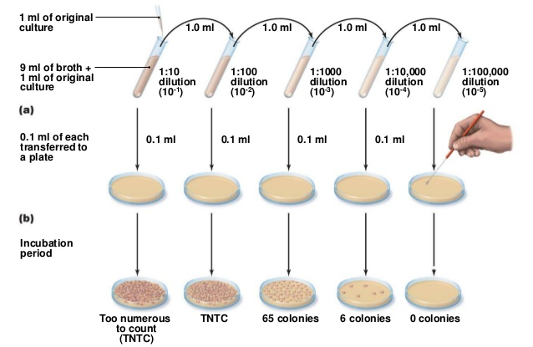
0.1 mL of original sample
0.1 mL
0.1 mL
0.1 mL
0.1 mL
0.9 mL of saline solution

